Slide 1
SQL injection and database security
Reporter:代翔

Slide 2
Table of contents
01
03
02
04
SQL Injection Overview
Defense Methods for SQL Injection
Principles of SQL Injection
Database Security Policies

Slide 3


01
SQL Injection Overview

Slide 4

WHAT IS SQL INJECTION?
The vulnerability of maliciously controlling the program database by controlling the key variables passed to the operation statement of the program database to obtain useful information or create malicious damage, or even control the user's computer system, is called "SQL injection vulnerability",which may
cause data leakage,elevation of privilege,data tampering,system crash and etc.

Slide 5


Principles of SQL Injection
02

Slide 6
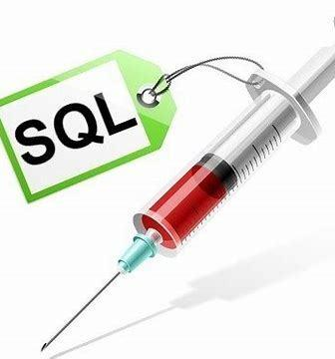
SQL injection is a common cyber attack technique in which an attacker injects maliciously crafted SQL code into the input fields of a web application to trick the backend database into executing unexpected SQL commands.
HOW DOES IT WORK?
Digital injection
Stacking injection
An attacker executes multiple SQL statements in a query, usually separating multiple statements by adding a semicolon to the end of the SQL statement. This injection method can be used to perform malicious operations such as deleting tables, shutting down databases, and so on.
The attacker injects numeric values into the input parameters and uses these values to alter the original SQL query logic. For example, by adding additional conditions to query parameters, validation logic can be bypassed and illegal data access or manipulation can be achieved.
Time-blind injection
UNION injection
An attacker constructs SQL statements to cause a delayed response to the database, and infers the database information based on the difference in response time. This approach is useful when the application does not display database errors or direct responses.
An attacker injects the UNION statement to merge the constructed SELECT query with the result of the original query to obtain additional database information. This type of injection typically requires an attacker to guess or probe the number of columns and type of the original query.

Slide 7
The UNION operator in SQL is used to merge the result set of two or more SELECT statements. When UNION is used, each SELECT statement must have the same number of columns, and the data types of the corresponding columns must be similar.
WHAT IS UNION?

Slide 8
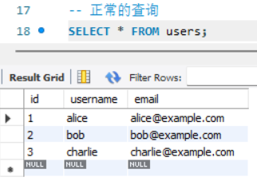
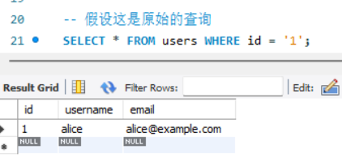
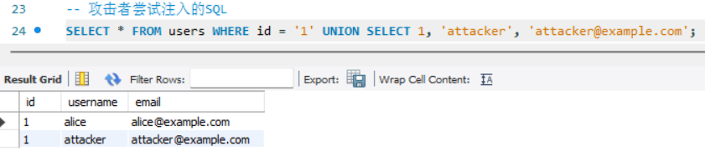

Slide 9

Defense Methods for SQL Injection
03

Slide 10
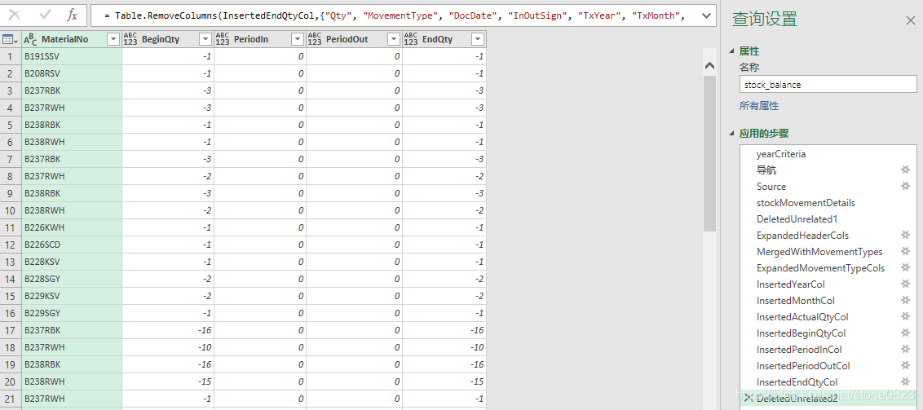
Defense Methods for SQL Injection
Use parameterized queries
This is one of the most effective ways to prevent SQL injection. Parameterized queries ensure that input values are not interpreted as SQL code, but are processed as data.

Slide 11
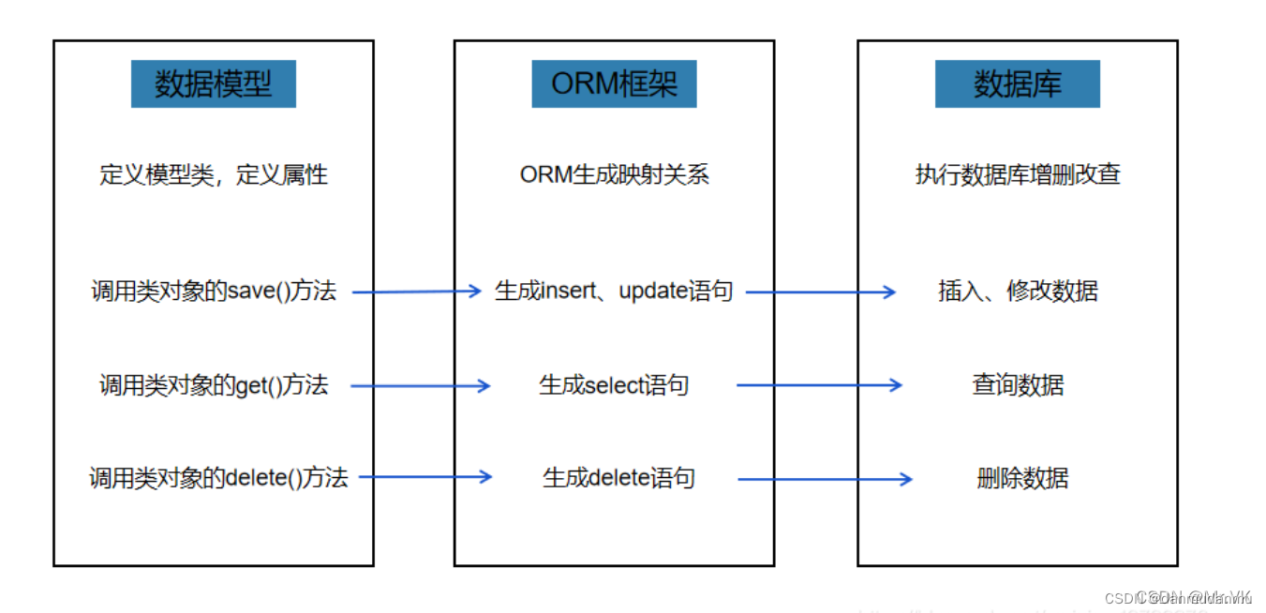
Defense Methods for SQL Injection
Use ORM frameworks
Object-relational mapping (ORM) frameworks often provide built-in protections against SQL injection.

Slide 12
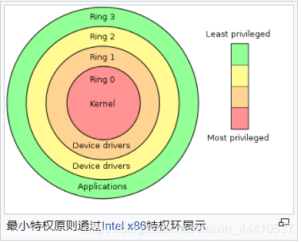
Defense Methods for SQL Injection
Principle of least privilege
Ensuring that database users have only the least privileges they need to perform their tasks reduces the number of actions an attacker can perform.

Slide 13

Database Security Policies
04

Slide 14
Failure cases in the world
Equifax data breach
In 2017, Equifax, a large credit reporting agency, suffered a major data breach that affected the personal data of approximately 147 million people.
Capital One data breach
In 2019, Capital One Bank suffered a data breach in which a hacker exploited a server misconfiguration to conduct a SQL injection attack that managed to obtain the personal information of more than 100 million customers.
Huge financial losses and reputational damage

Slide 15
Database Security Policies
Encryption
Security audit
01
03
Sensitive data is stored and transmitted in an encrypted manner.
Records and analyzes database access logs to detect abnormal behaviors in a timely manner.
Access control
Continuous updates:
02
04
Implement strict access control policies, such as IP whitelisting and multi-factor authentication
Databases and applications are regularly updated to fix known security vulnerabilities.

Slide 16
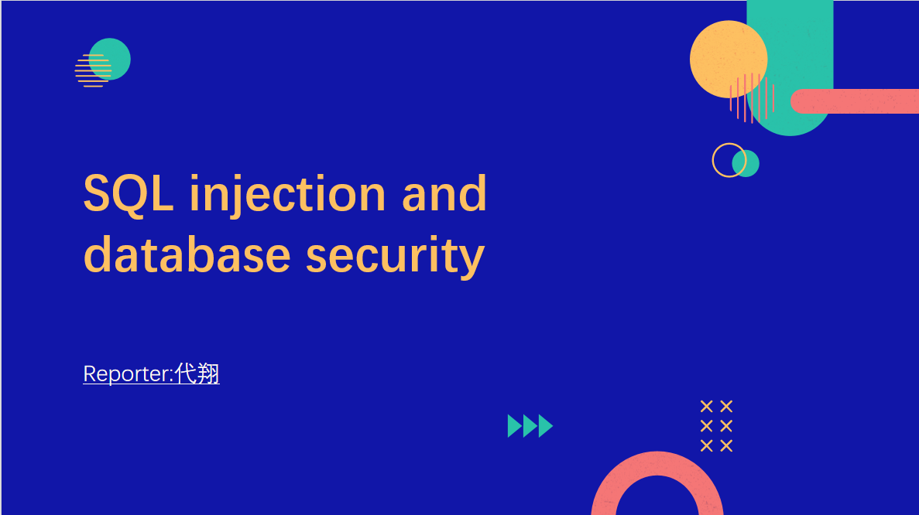
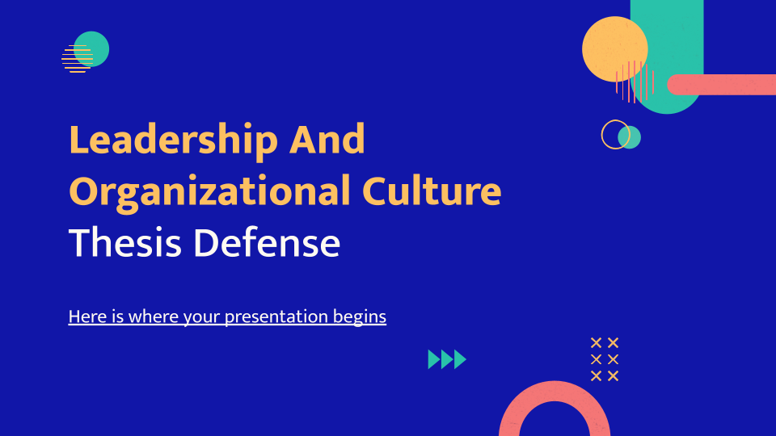
Thanks for Listening!

